Slide 1
Multi-Level Structured Self-Attentions for Distantly Supervised Relation Extraction
Source: EMNLP 2018
Advisor: Jia-Ling, Koh
Speaker: Ming-Chieh, Chiang
Date: 2019/03/11

Slide 2
Outline
Introduction
Method
Experiment
Conclusion

Slide 3
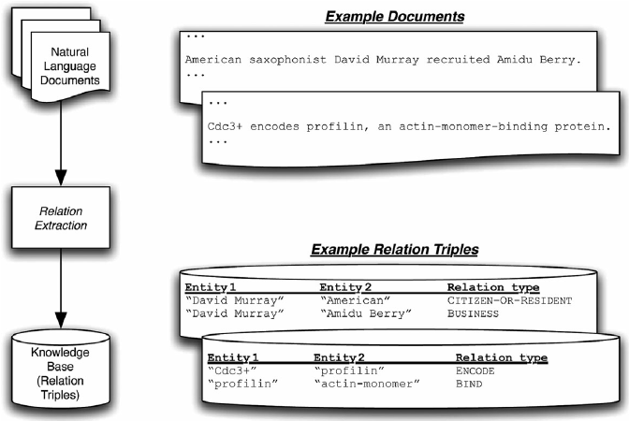
Relation Extraction
Notes:
美國薩克斯風演奏者大衛雇用OOO
肌動單體蛋白結合蛋白

Slide 4
Distant Supervision
Capital_Of(Tokyo,Japan)
Founder_Of(Bill Gates,Microsoft)
Knowledge Base
 | Sentences | Label
S1 | Tokyo, Japan’s capital, was originally a small village . | Capital_Of
S2 | Bill Gates is a co-founder of the Microsoft Corporation. | Founder_Of

Slide 5
Distant Supervision
Suffer from wrong labelling problem
Example:
  Bill Gates ’s turn to philanthropy was linked to the antitrust problems Microsoft had in the U.S. and the European union.

Slide 6
Motivation
Problem
  Entity pair-targeted context representation learning from an instance.
  Valid instance selection representation learning over multiple instances.
Attention
  1-D attention vector ignores different semantic aspects of the sentence.

Slide 7
Goal
Entity pair(e1,e2)
A bag G containing J instances
Relation label r
Denoise instances by selecting valid candidates based on relation r.

Slide 8
Outline
Introduction
Method
Experiment
Conclusion

Slide 9
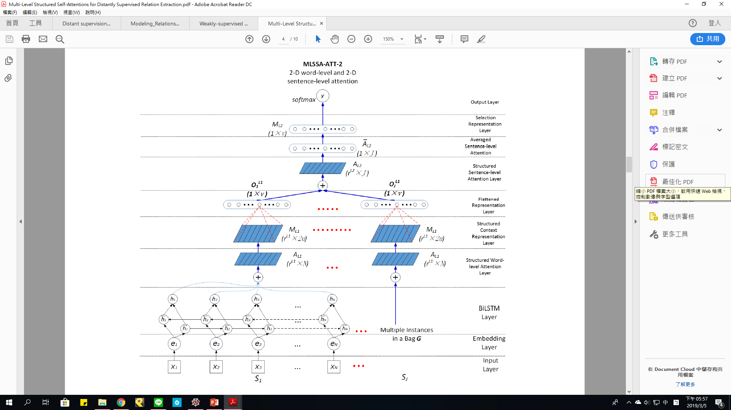
Framework

Slide 10
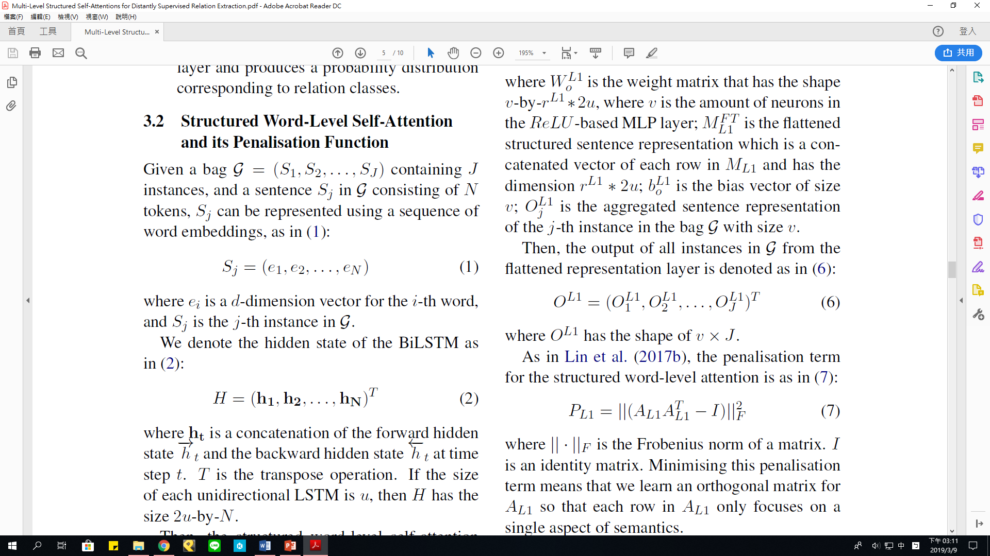
Bi-LSTM
Bi-LSTM

Slide 11
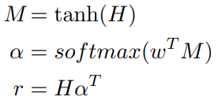
Attention
u: dim of hidden state
n: words length
1
n
n
1
=
u
X
u

Slide 12
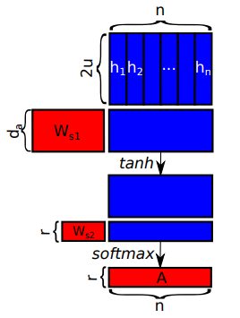


Self-Attention
r:不同層面的重要性
(r x 2u)
(da x n)
(da x 2u)
n
(r x n)
n
(r x da)
r
1

Slide 13


Word-Level Self-Attention
Flattened Representation
Penalization Term

Slide 14
Penalization Term
希望某個字只針對一個概念
Example (r=2,n=3)
  1) : =
  2) : =
0.4 | 0.3 | 0.3
0.2 | 0.6 | 0.2
0.34 | 0.32
0.32 | 0.44
1 | 0 | 0
0 | 0 | 1
1 | 0
0 | 1

Slide 15

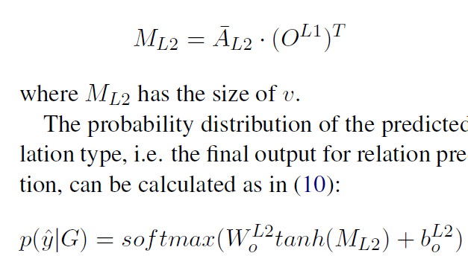
Sentence-Level Self-Attention
J
r
1
J

Slide 16
Outline
Introduction
Method
Experiment
Conclusion

Slide 17
Dataset
 | NYT corpus |  | DBpedia Portuguese (PT)
 | Training | Testing | Training (0.7) | Testing(0.3)
# of relationships | 53 |  | 10
# of sentences | 580,888 | 172,448 | 96,847
# of entity pairs | 292,484 | 96,678 | 85,528
# of relational facts | 19,429 | 1,950 | 77,321
Entity pairs corresponding to instances | 19.24% | 22.57% | 8.61%

Slide 18
Baselines
CNN+ATT
PCNN+ATT
BiGRU+ATT
BiGRU+2ATT(word-level + sentence-level)
MLSSA-1(2D word-level + 1D sentence-level)
MLSSA-2

Slide 19
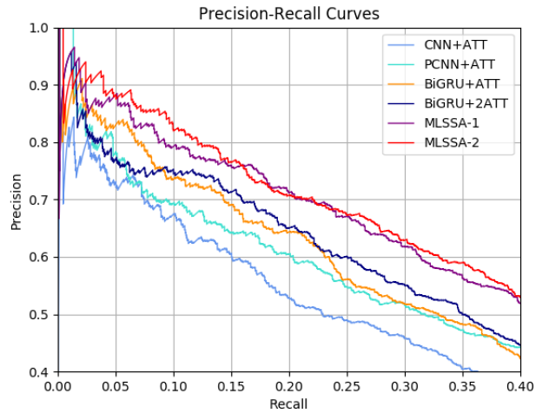
PR Curves on NYT

Slide 20
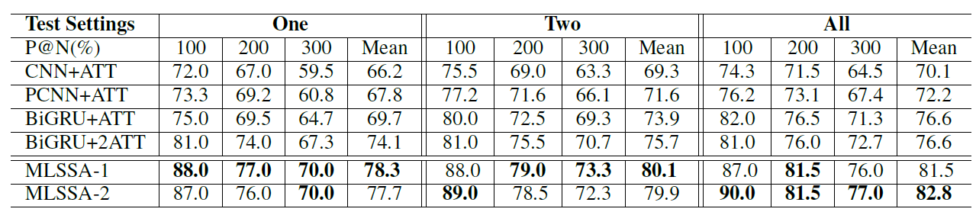
P@N Evaluation on NYT

Slide 21
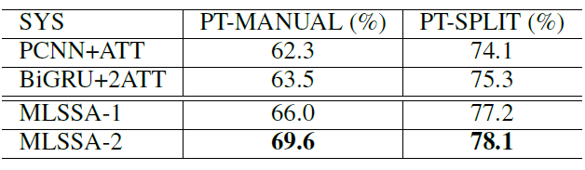
Result on PT Dataset
Macro-F1

Slide 22
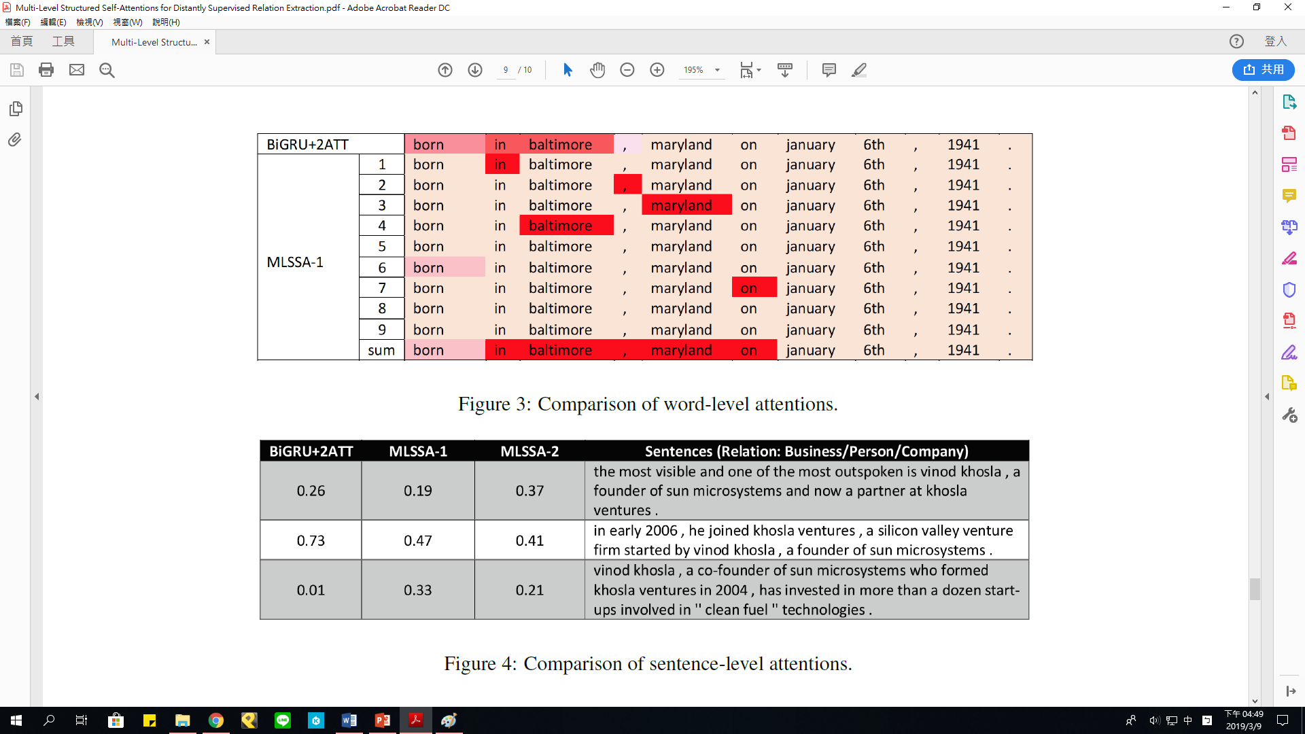
Word-Level Attentions

Slide 23
Sentence-Level Attentions
Entity pairs:
(vinod khosla, sun microsystems)
Notes:
企業家 昇陽電腦

Slide 24
Outline
Introduction
Method
Experiment
Conclusion

Slide 25
Conclusion
This paper has proposed a multi-level structured self-attention mechanism for DS-RE.
The proposed framework significantly outperforms state-of-the-art baseline systems.

